Slide 1

Navigating the Event
Security Immersion Experience
Wynnewood (1st Floor)
Azure Immersion Experience
Strafford (1st Floor)
IT Breakout Sessions
MPR 2
Developer Sessions
MPR 1

Slide 2
AI for Intelligent Cloud and Intelligent Edge: Discover, Deploy, and Manage with Azure ML Services
Dave Wentzel
Data & AI Technical Architect
Microsoft Technology Center – Malvern/Philadelphia
davew@Microsoft.com
linkedin.com/in/dwentzel
aka.ms/davew_pts_azureml

Slide 3

What’s New in SQL Server 2019 Backup and Restore

Slide 4
Intro to Azure Machine Learning Manage and deploy AI models Increase perf. with HW acceleration Deploy AI models to the Edge
AI
Cloud+Edge

Slide 5
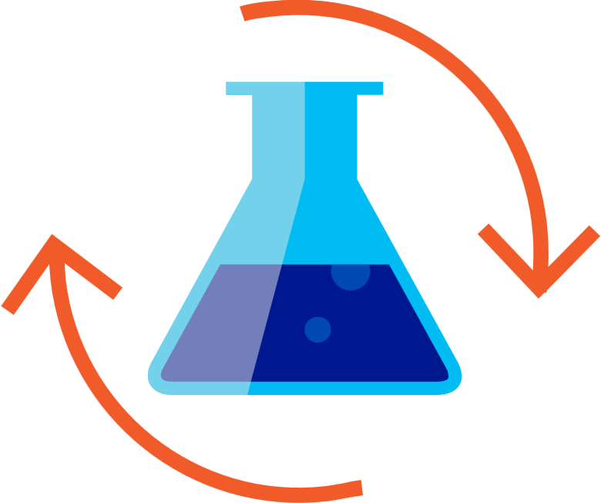

Custom AI
Building your own AI models for Transforming Data into Intelligence
Prepare Data
Build & Train
Deploy
Notes:
2016: data wrangling
2017: framework choice
2018: from reactive to predictive (webservice, realtime)
2019: AIOps – moving to the edge/less compute

Slide 6
What is Azure Machine Learning
Azure AI Services
PRE-BUILT AI
CONVERSATIONAL AI
CUSTOM AI
CODING & MANAGEMENT TOOLS
Cognitive Services
Tools
Bot Service
Azure Machine Learning
VS Tools for AI
Azure ML Studio
Azure ML SDK,CLI and Web UX
Others (PyCharm, Jupyter Notebooks…)
Azure Infrastructure
DEEP LEARNING FRAMEWORKS
AI ON DATA
AI COMPUTE
3rd Party
Cosmos DB
SQL
DB
SQL
DW
Data Lake
Spark
DSVM
Batch AI
ACS
IoT Edge
Cognitive Toolkit
TensorFlow
Pytorch
CPU, FPGA, GPU
Others (Scikit-learn, MXNet, Keras, Chainer, Gluon…)

Slide 7
Model Management Hardware Acceleration Edge Integration
AI
Cloud +
Edge

Slide 8

Building your own AI models
Step 3: Deploy
Azure Kubernetes Service (AKS)
Azure Batch
Azure Machine Learning
Docker Containers
Azure IoT Edge
Any other container host…

Slide 9
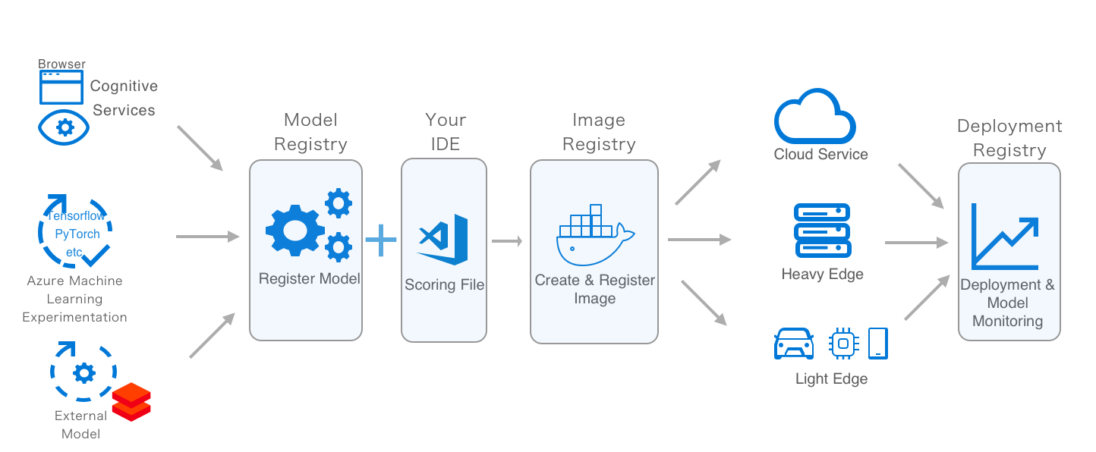
Deploying models at scale

Slide 10
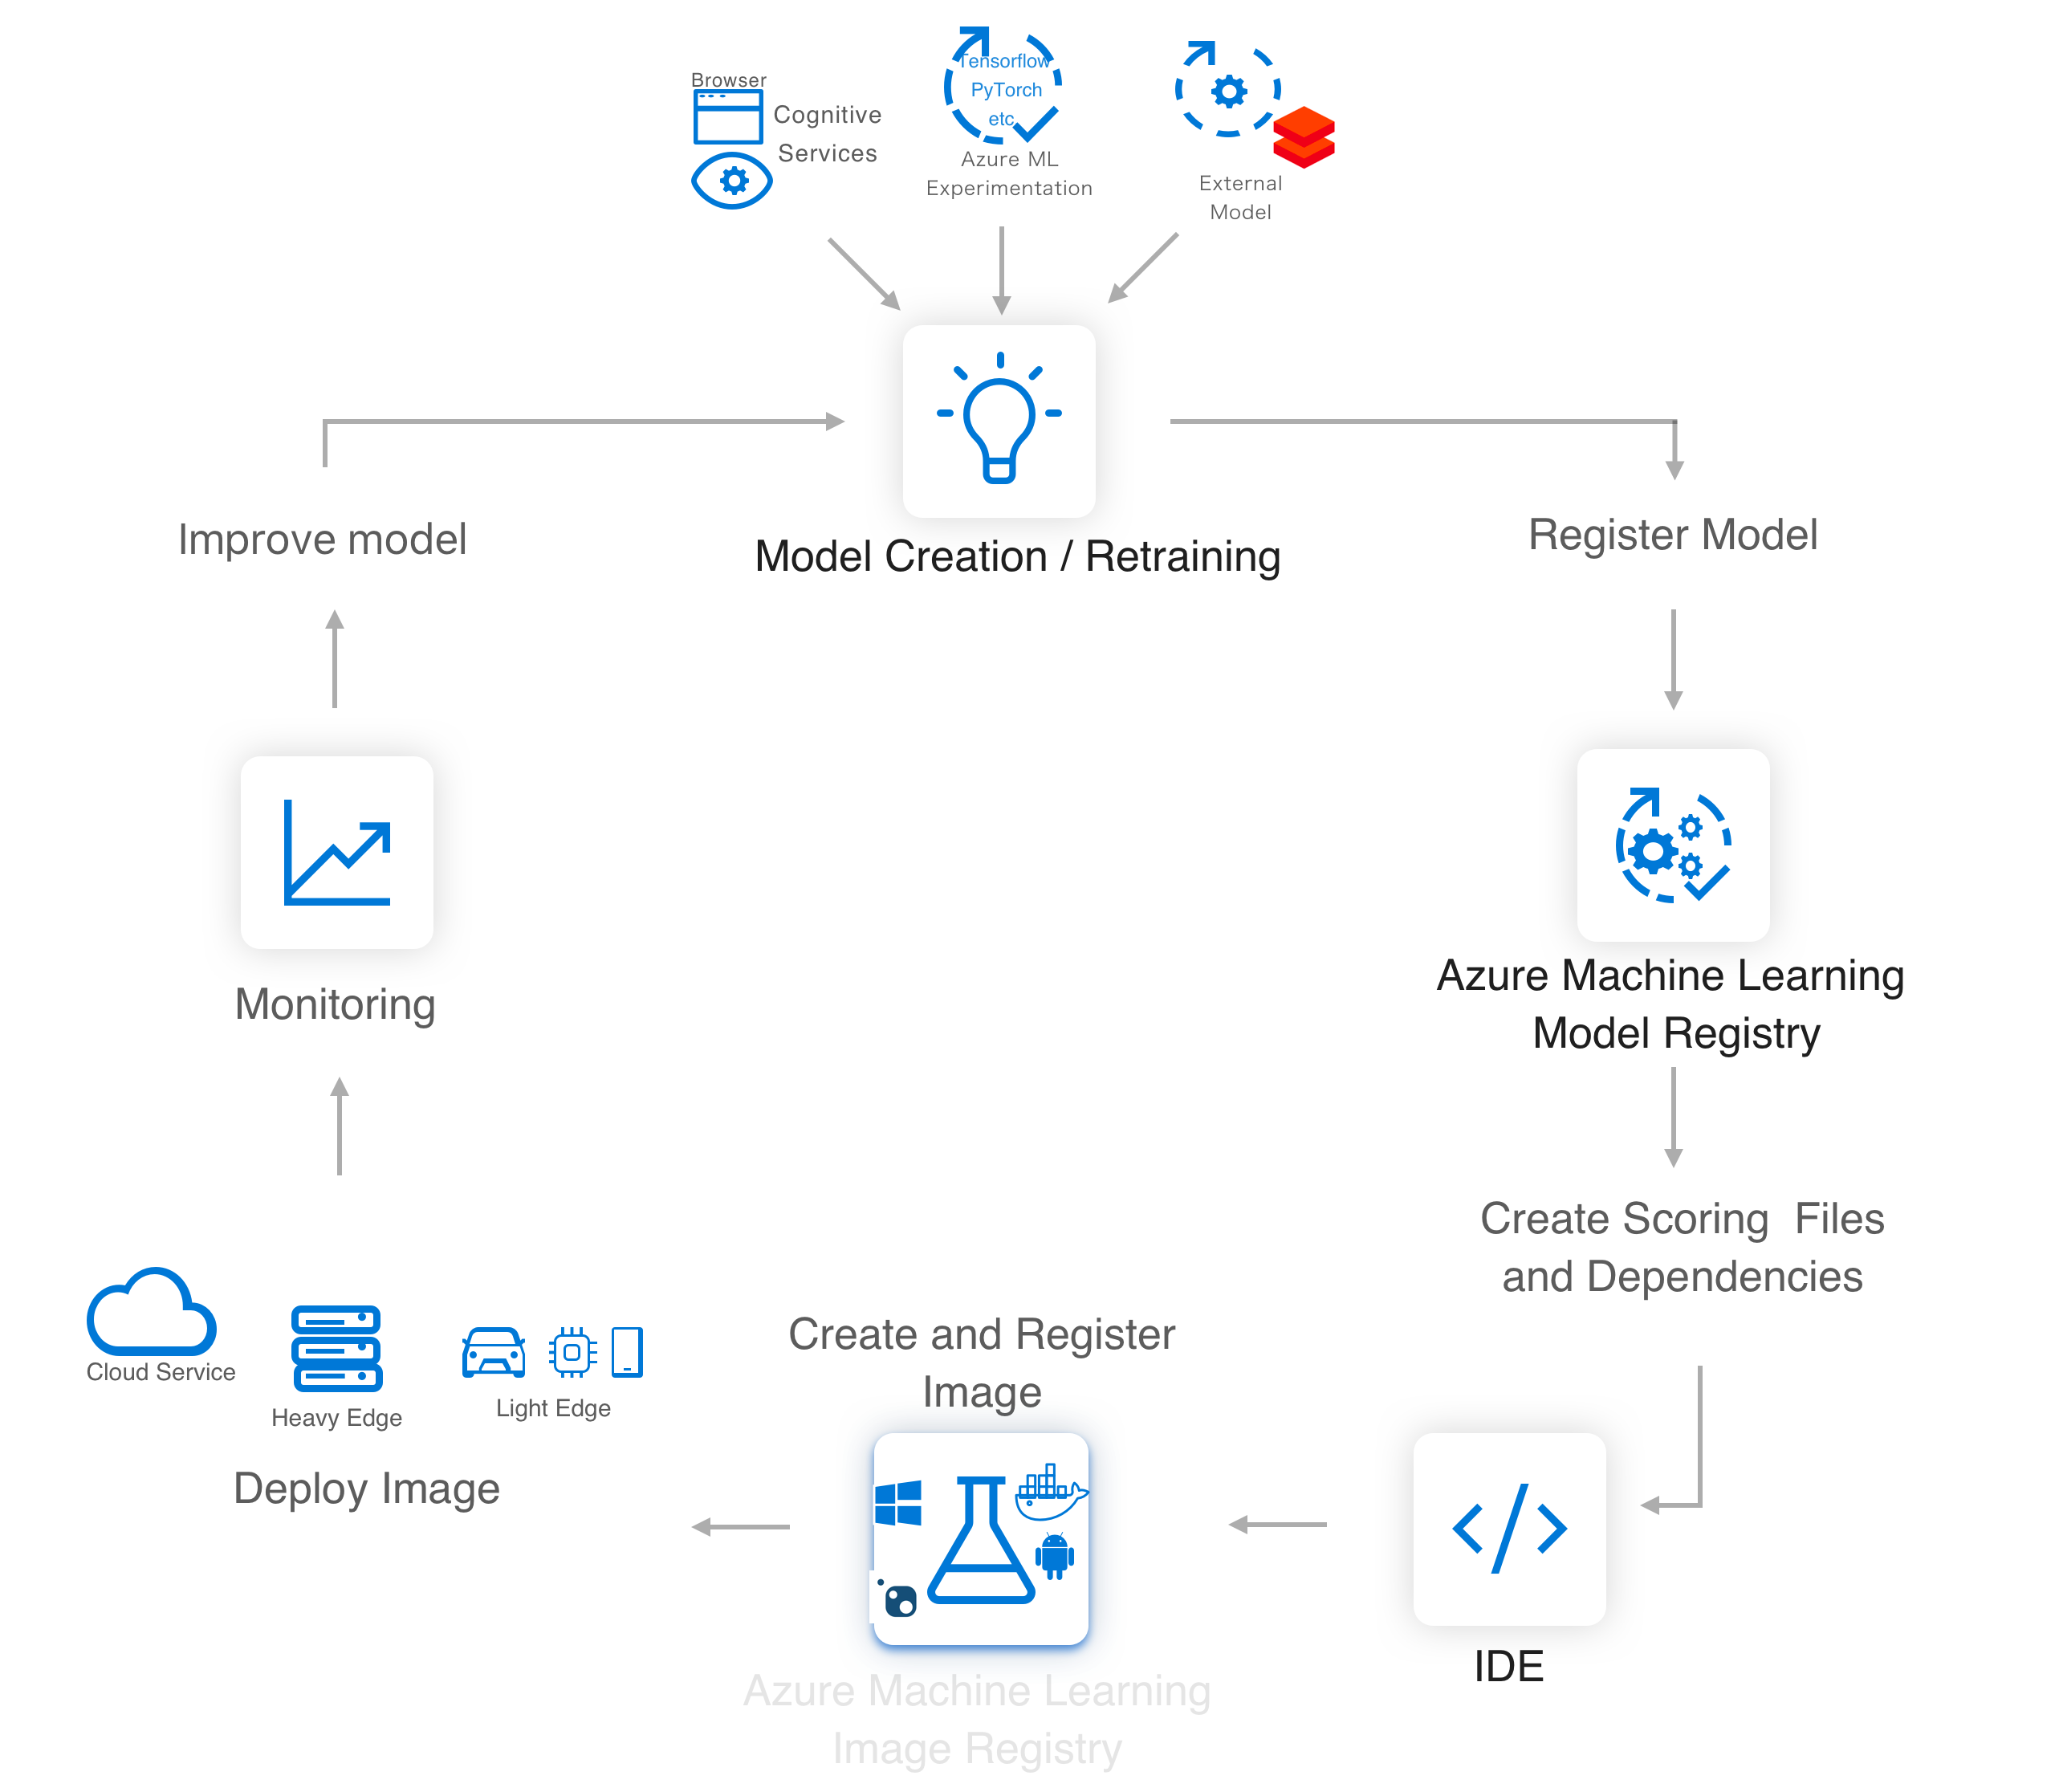
AIOps/MLOps

Slide 11
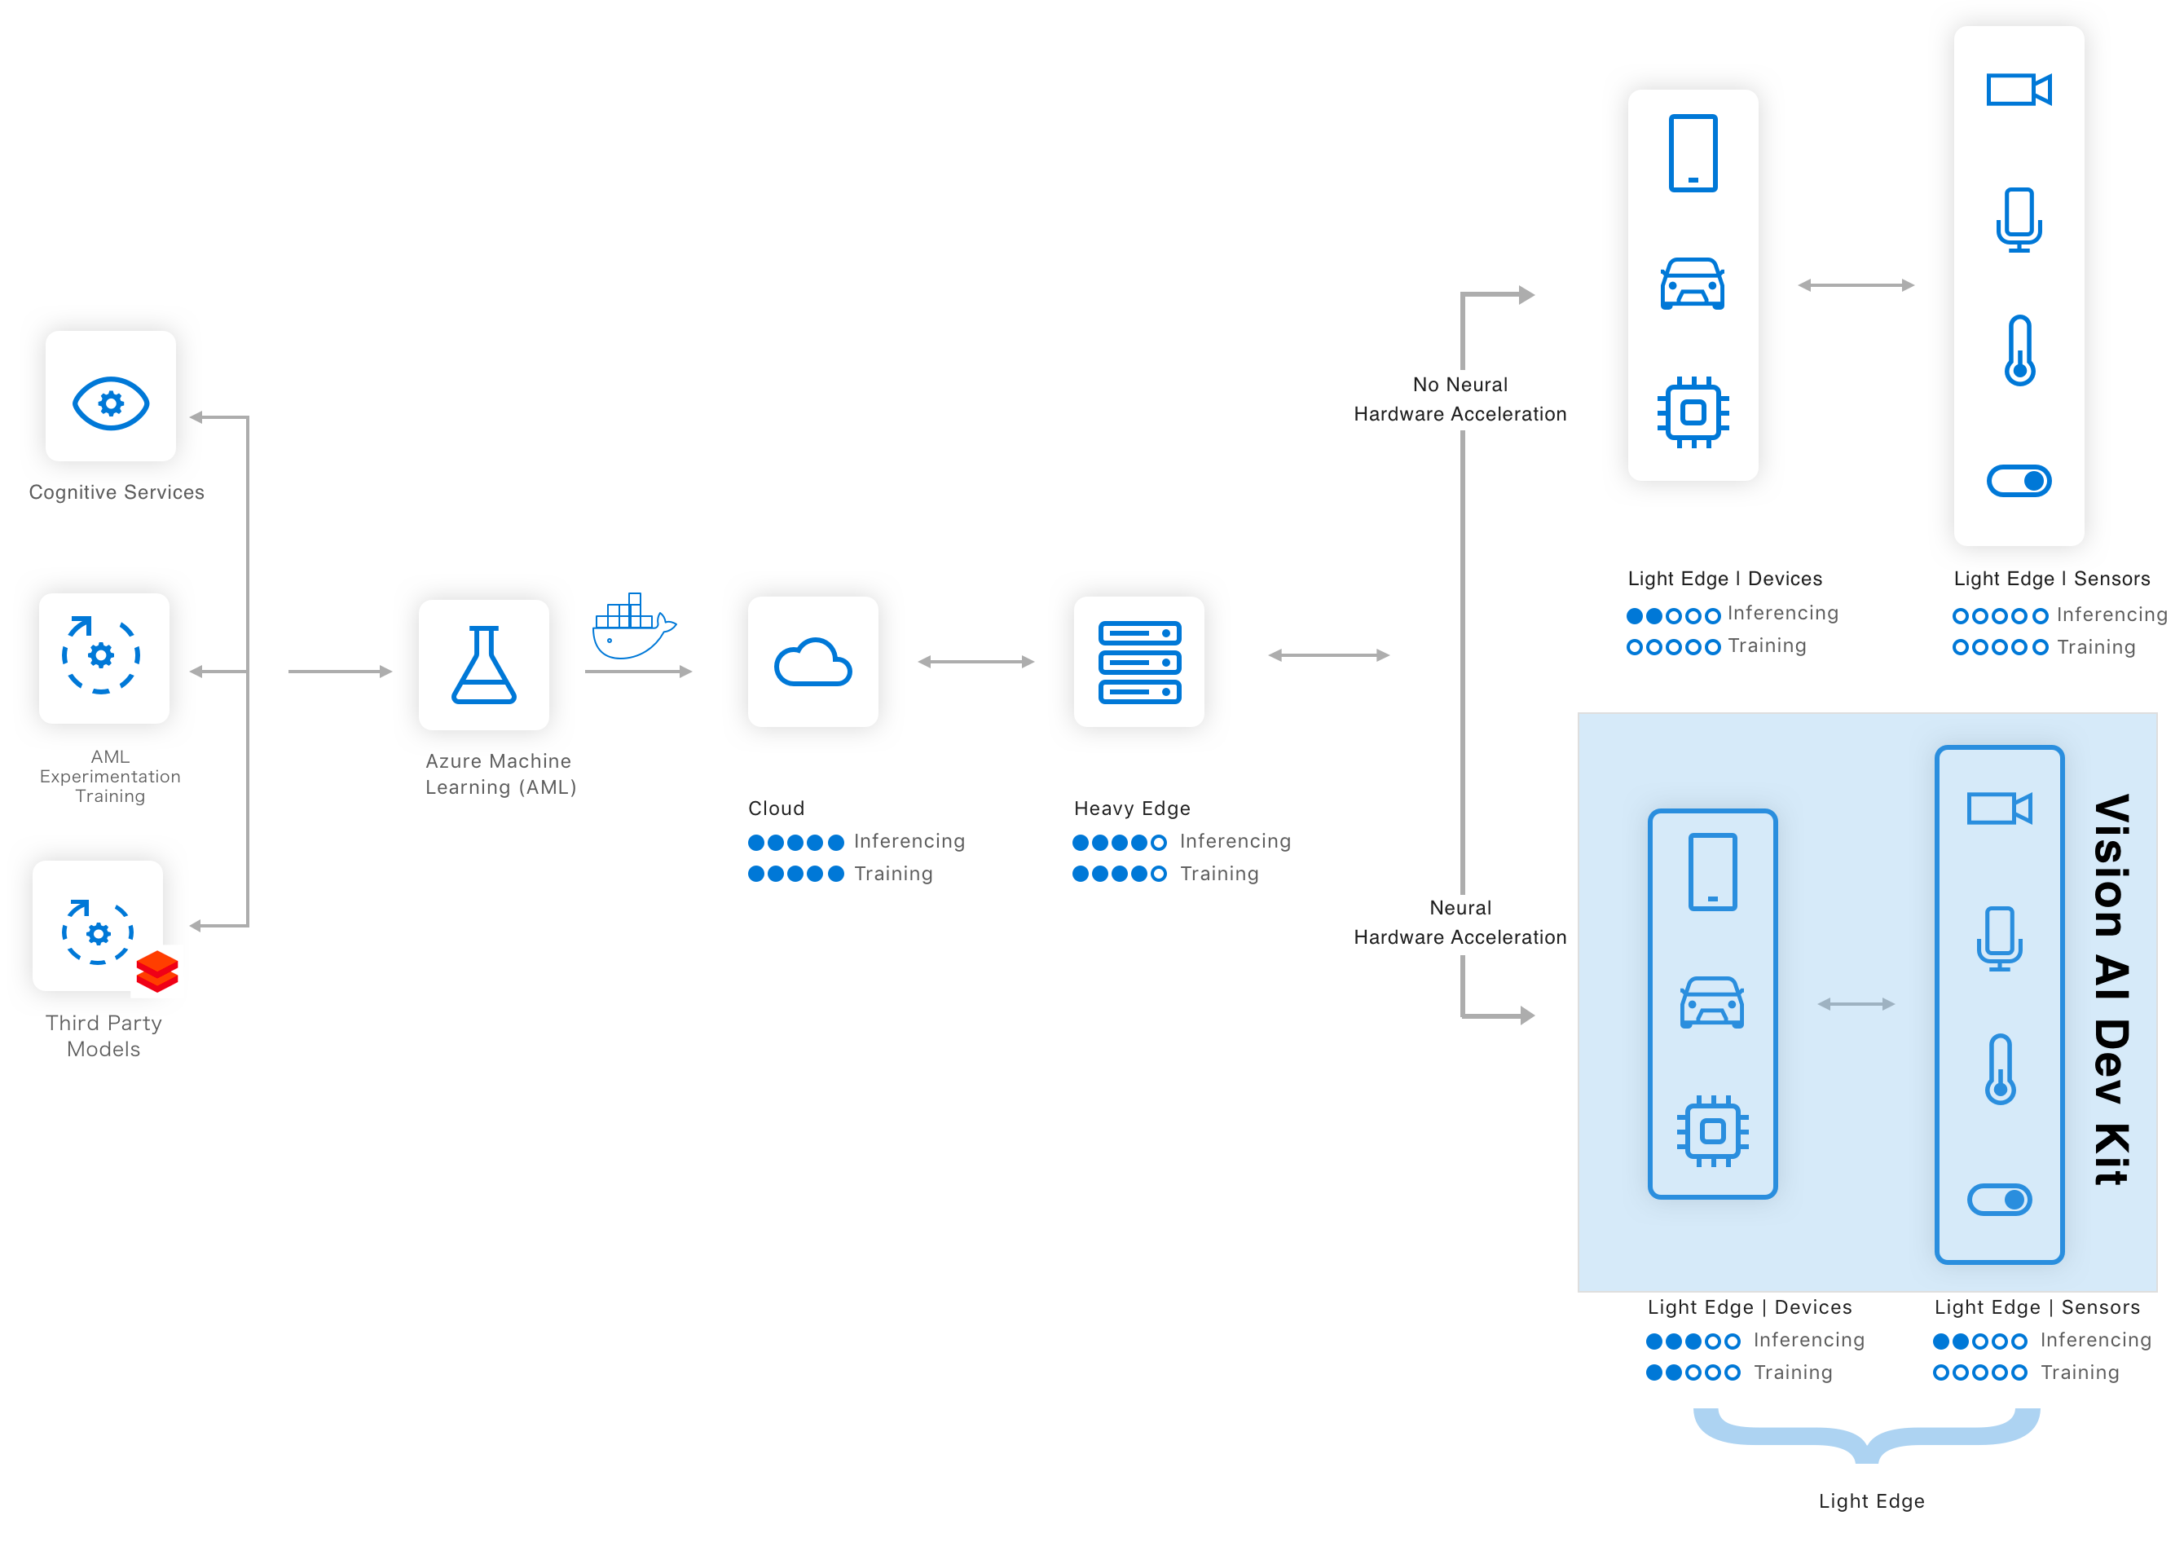

The Azure ML Deployment Pipeline

Slide 12
Understanding the Edge: Heavy Edge vs Light Edge
 | Cloud: Azure | Heavy Edge |  |  |  | Light Edge
Description | An Azure host that spans from CPU to GPU and FPGA VMs | A server with slots to insert CPUs, GPUs, and FPGAs or a X64 or ARM system that needs to be plugged in to work |  |  |  | A Sensor with a SOC (ARM CPU, NNA, MCU) and memory that can operate on batteries
Example | DSVM / ACI / AKS / Batch AI | - DataBox Edge - HPE Azure Stack | DataBox Edge | Industrial PC | -Video Gateway -DVR | -Mobile Phones -VAIDK | -Mobile Phones -IP Cameras | -Azure Sphere - Appliances
What runs model | CPU,GPU or FPGA | CPU,GPU or FPGA | CPU, GPU | x64 CPU | Multi-ARM CPU | Hw accelerated NNA | CPU/GPU | MCU
Cloud Consistent
Hybrid Server
PC class devices
Smart Sensors + Ambient AI
Servers
Gateway
Sensors
Notes:
MCU: microcontroller unit. More on chip than MPU

Slide 13
Model Management and Deployment Demo

Slide 14
Model Management Hardware Acceleration Edge Integration
AI
Cloud +
Edge

Slide 15
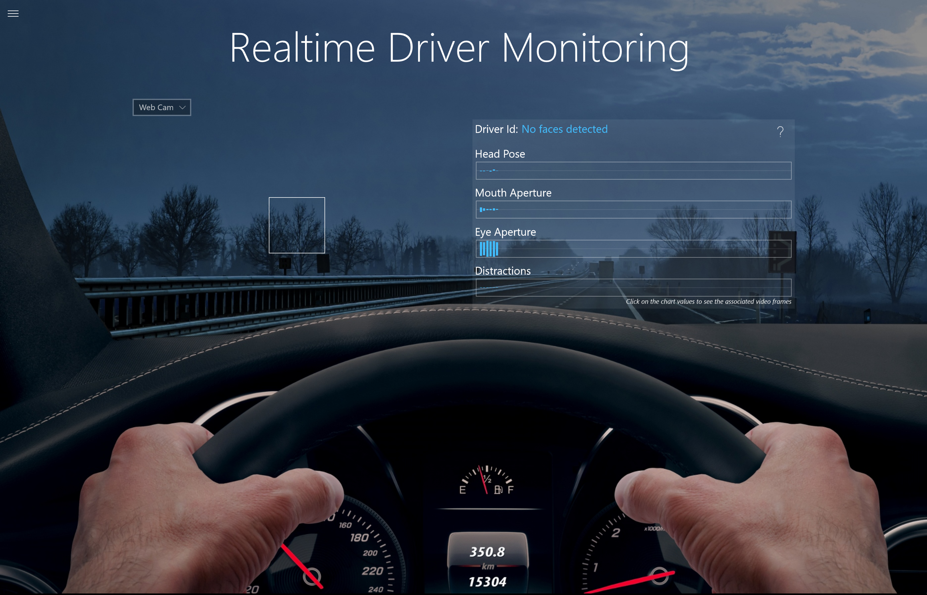
AI in Action

Slide 16
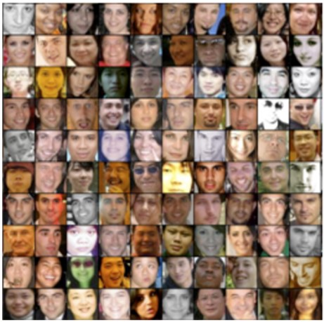
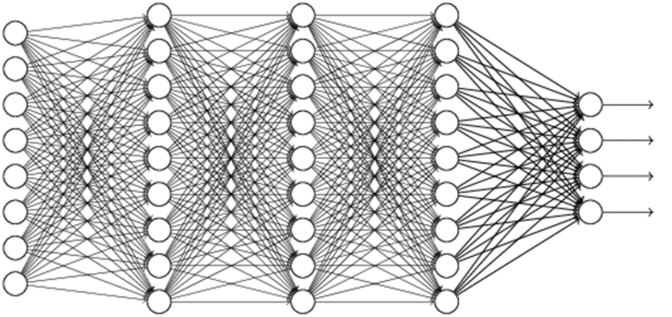
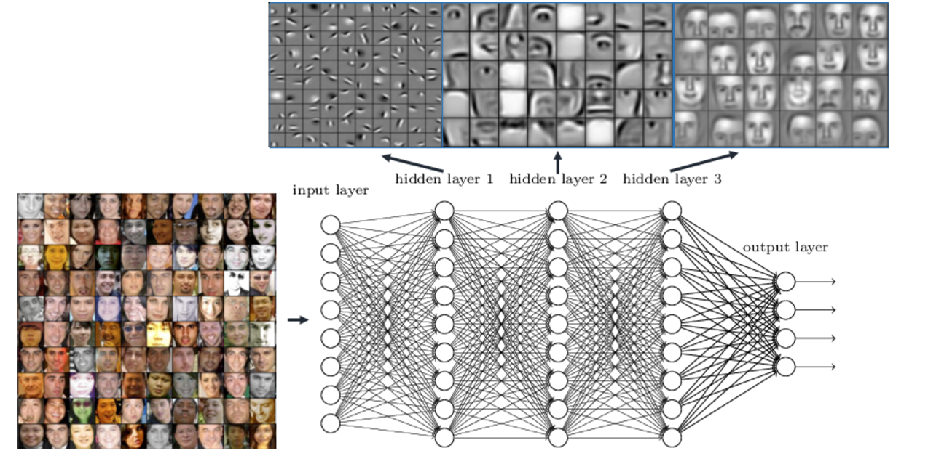
Breakthroughs in deep learning demand real-time AI
Recurrent Neural Networks
y_{t-1}
y_{t}
y_{t+1}
Deep neural networks have enabled major advances in machine learning and AI
Computer vision
Language translation
Speech recognition
Question answering
And more…
Problem DNNs are challenging to serve and deploy in large-scale online services
Heavily constrained by latency, cost, and power
Size and complexity outpacing growth of commodity CPUs
h_{t-1}
h_{t}
h_{t+1}
h_{t-1}
h_{t}
h_{t+1}
x_{t-1}
x_{t}
x_{t+1}
Convolutional Neural Networks

Slide 17


Microsoft Hardware Acceleration
Edge
Cloud
CPUs
GPUs
FPGAs
ASICs
FLEXIBILITY
EFFICIENCY
TRAINING CPUs and GPUs
INFERENCING CPUs, GPUS, FPGAs
TRAINING
(HEAVY EDGE) CPUs and GPUs
INFERENCING CPUs, GPUS, FPGAs, ASICs
Notes:
ASIC: application specific integrated circuits
fpga at Kroger: out-of-stock vs off-the-shelf

Slide 18
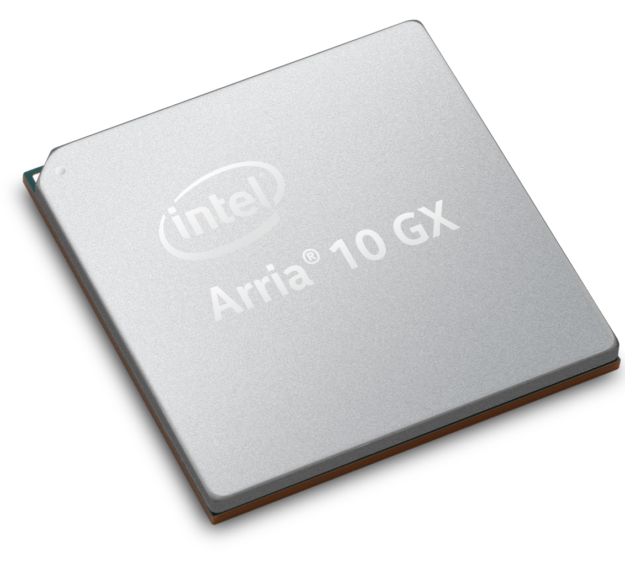
Project Brainwave unique advantage No batching required
Brainwave
Performance
NPU
256
Batch Size
1
Brainwave delivers the ideal combination:
High hardware utilization
Low latency
Low batch sizes
Notes:
cpu, gpu, fpga analogies
NPU: neural processing unit

Slide 19
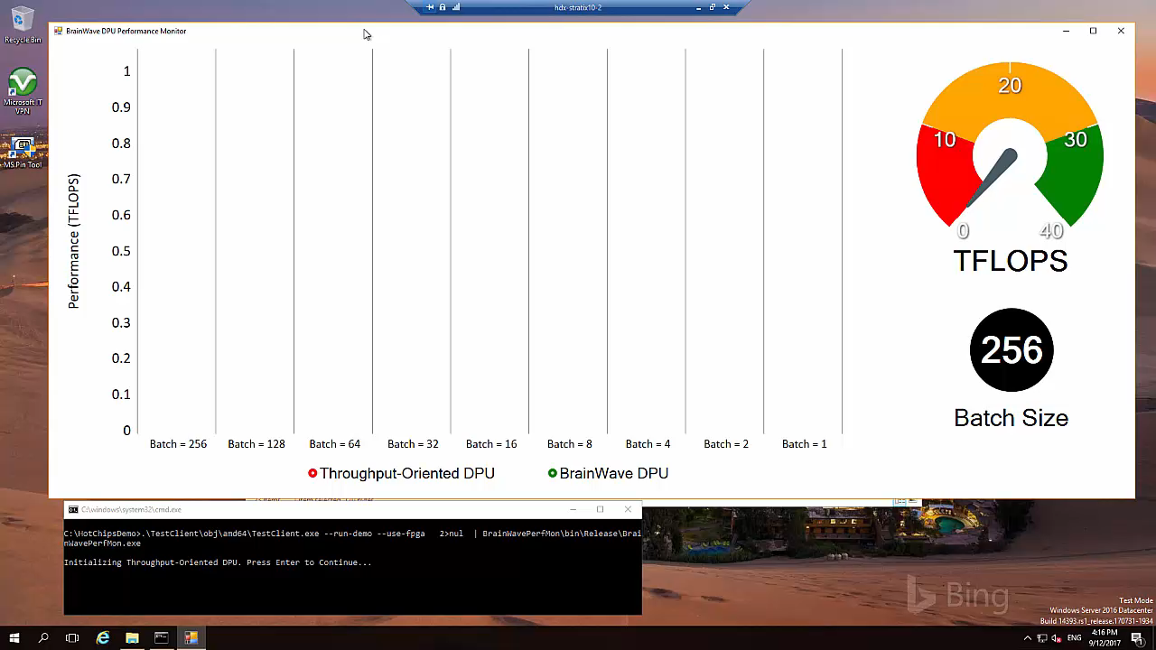

Slide 20
The power of deep learning on FPGA
Performance
Flexibility
Scale
Excellent inference at low batch sizes
Ultra-low latency | 10x < CPU/GPU
Rapidly adapt to evolving ML
Inference-optimized numerical precision
Exploit sparsity, deep compression
World’s largest cloud investment in FPGAs
Multiple Exa-Ops of aggregate AI capacity
Runs on Microsoft’s scale infrastructure
Low cost
$0.21/million images on Azure FPGA
Notes:
MCHP example with FPGAs
accelerated networking

Slide 21
Project BrainWave
A Scalable FPGA-Powered DNN Serving Platform
Fast: Ultra-low latency, high-throughput serving of DNN models at low batch sizes
Flexible: Future proof, adaptable to fast-moving AI space and evolving model types
Friendly: Turnkey deployment of TensorFlow/CNTK/Caffe/etc.
L1
Network switches
Instr Decoder & Control
L0
L0
FPGAs
Neural FU
F
F
F
F
F
F
Pretrained DNN Model in TensorFlow, CNTK, etc.
Scalable DNN Hardware Microservice
BrainWave Soft DPU
Notes:
ONNX

Slide 22
Model Management Hardware Acceleration Edge Integration
AI
Cloud +
Edge

Slide 23
Why Intelligent Edge?
High-speed data processing, analytics and shorter response times are more essential than ever.
Intelligent Cloud
Business agility and scalability: unlimited computing power available on demand.
Intelligent Edge
Can handle priority-one tasks locally even without cloud connection.
Can handle generated data that is too large to pull rapidly from the cloud.
Enables real-time processing through intelligence in or near to local devices.
Flexibility to accommodate data privacy related requirements.
Intelligent Cloud
Intelligent Edge
Notes:
drill rigs

Slide 24
The Azure ML Deployment Pipeline

Slide 25
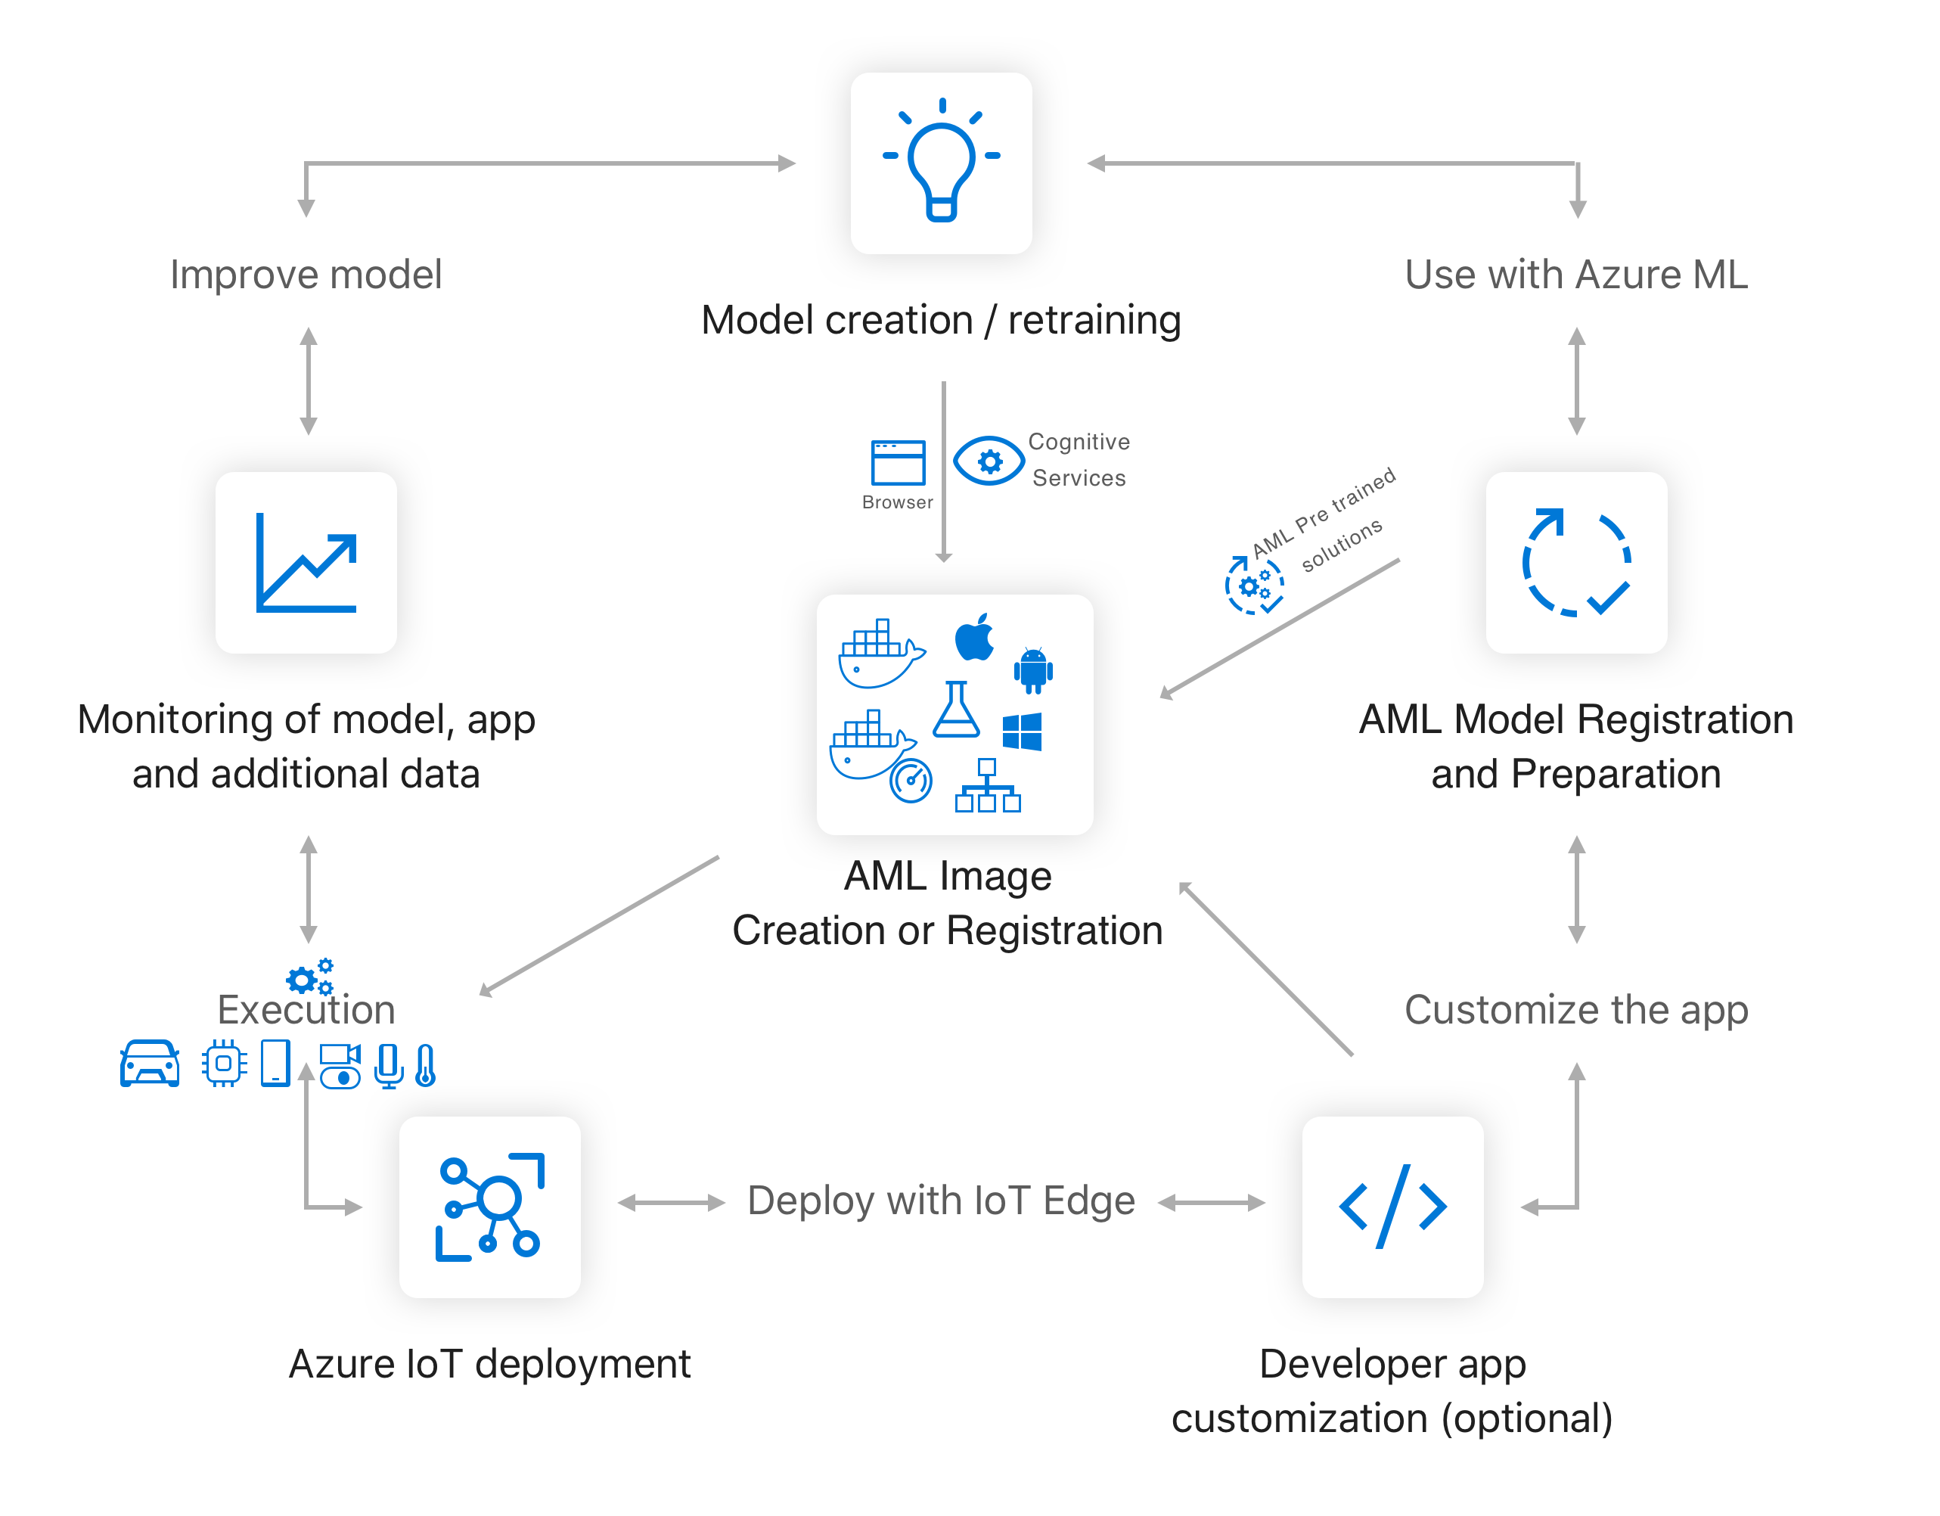
Building AI Solutions for the Intelligent Edge

Slide 26
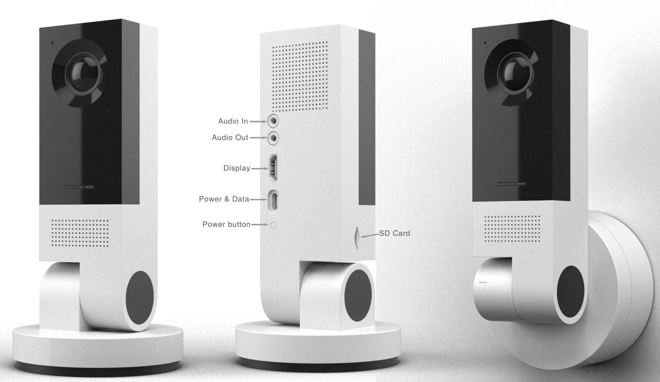
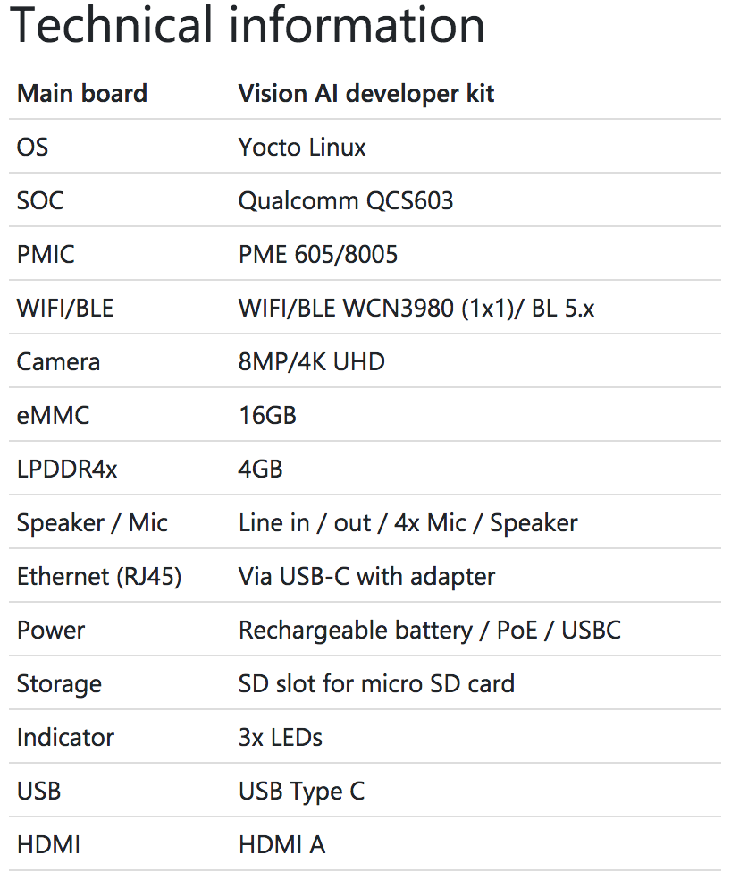
Vision AI Developer Kit Hardware Specification

Slide 27
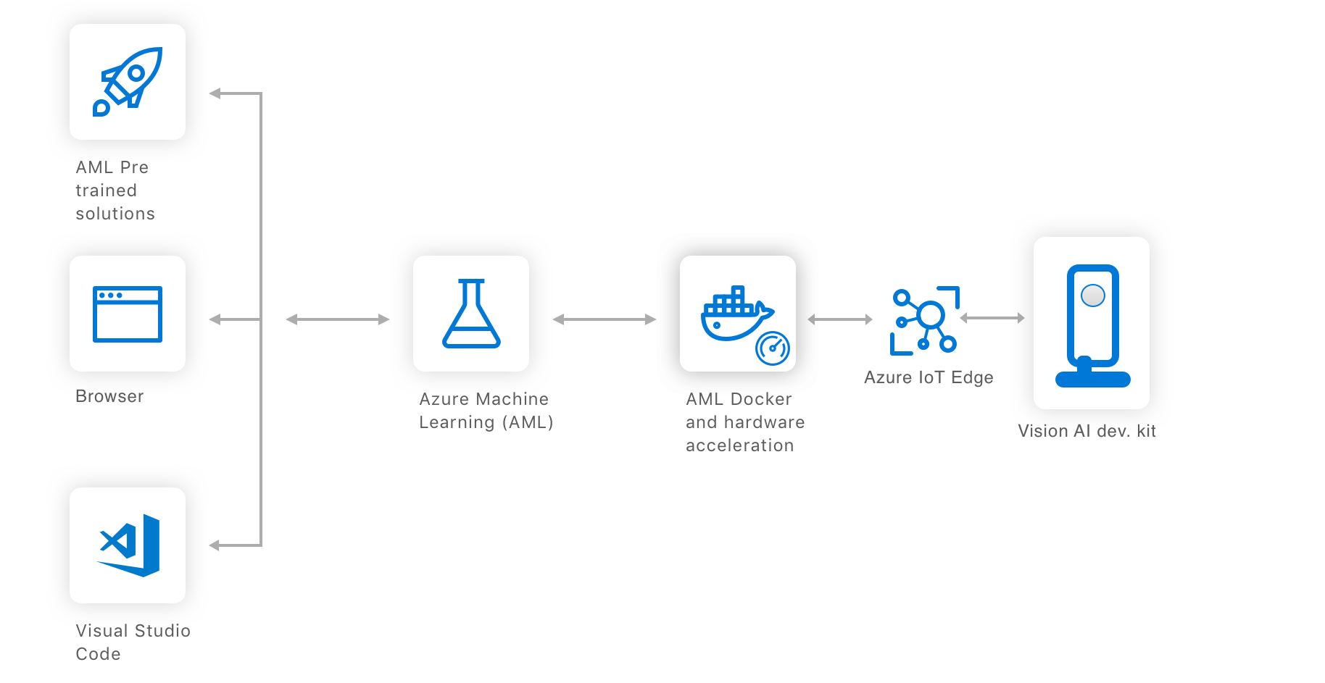
Vision AI Development kit – System Architecture

Slide 28
AI for Intelligent Cloud and Intelligent Edge: Discover, Deploy, and Manage with Azure ML Services
Dave Wentzel
Data & AI Technical Architect
Microsoft Technology Center – Malvern/Philadelphia
davew@Microsoft.com
linkedin.com/in/dwentzel
aka.ms/davew_pts_azureml

